Slide 1

Managing your Corporate Master Data Assets
The Benefits of Riversand Master Data Management Solutions
Notes:
This PowerPoint Template includes a series of slide masters with predefined layouts and color schemes for formatting slides
Slide Masters are displayed when you right click on a slide and select Layout from menu

Slide 2
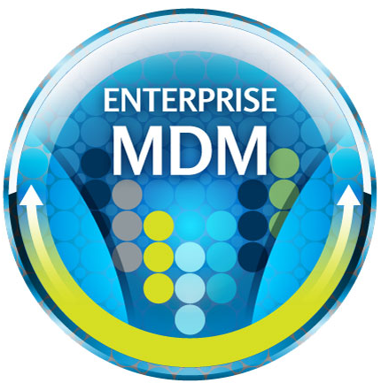

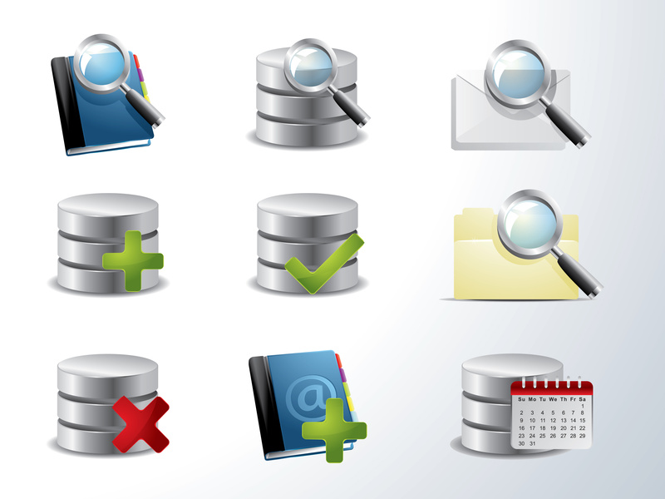


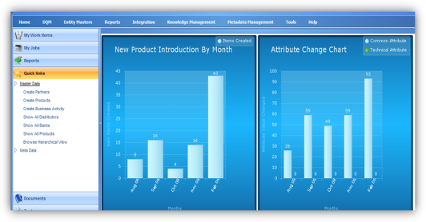

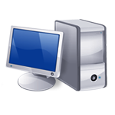

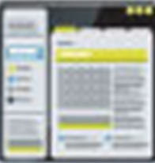



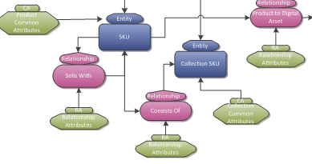
Riversand’s Solution fully enables multi-domain MDM for NFP’s Lines of Business
PRODUCT
PRODUCT TYPE
REPS/AGENT
HR REP
Data
Globalization
Entity
Explorer
CUSTOMER
ACCOUNTS
SPONSOR
CUSTODIAN
Reporting &
Analysis
Workflow
FIRM
BRANCH
Matching &
Merging
Performance &
Scalability
Data
Governance
Data
Integration
Relationship
Management
Flexible
Data Model

Slide 3
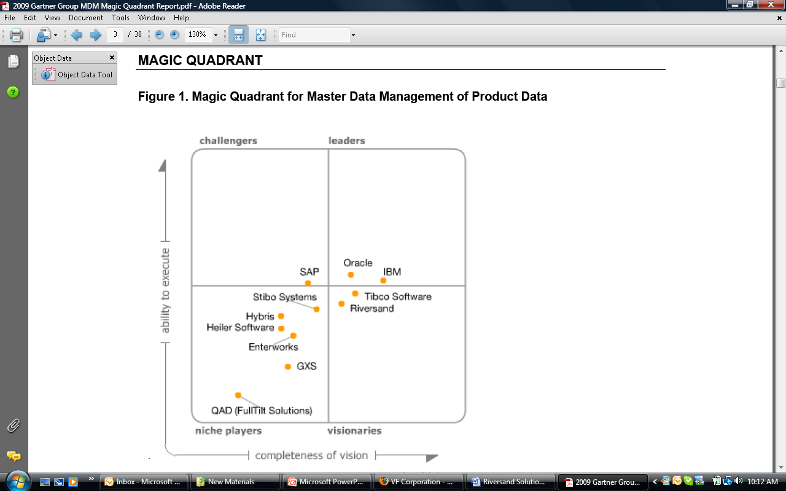
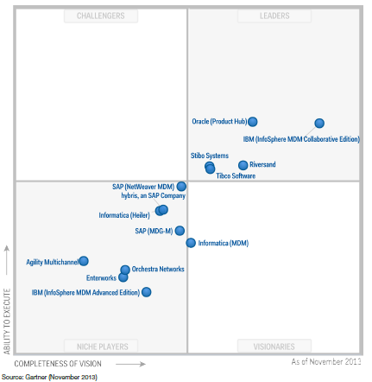
Riversand: the highest-rated pure-play MDM provider
Riversand established as the most innovative company in the “Leaders” Quadrant
Gartner’s MQ report highlights Riversand's strengths:
Business Strategy
Market Growth/Momentum
“Leader" functionality and product strategy
References and customer base
Solid partner program
2012
2011
2010
2009

Slide 4
Trends in Master Data Management- Build vs. Buy
In 2013, 75% of organizations had purchased or intended to purchase a packaged solution with only 10% claiming they would build one in-house (down from 18% in 2008).¹
The median number of systems that generate master data was 15 with 43% having between 10 and 30 systems.¹
56% of companies prefer a unified master data platform while 27% seek a solution optimized for a specific data domain.¹
23% of companies reported that MDM was now a well-established activity in their business (13% in 2008).¹
In 2013, 10% of Businesses estimate the annual costs of poor data is between $ 1 million and $ 10 million.(up from 4% in ‘12)¹
1 Source - “The Adoption of MDM by Business Revisited” The Information Difference, July 2013

Slide 5
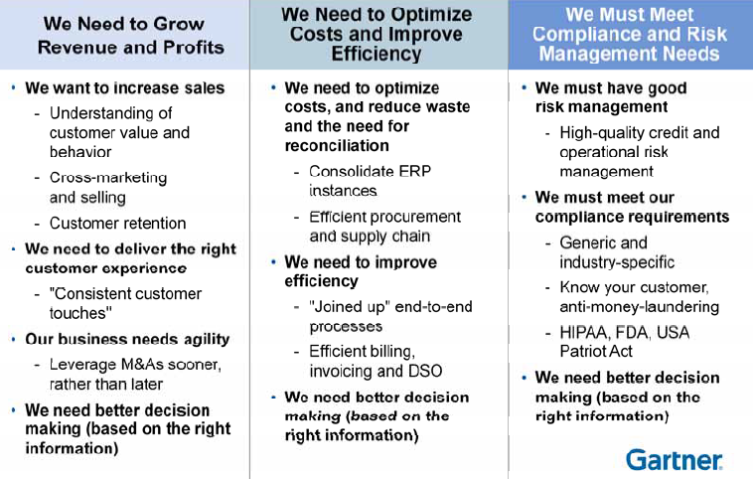
Linking MDM initiatives to Business Value
Notes:
1. This slide needs to be made relevant to NFP’s business and benefits

Slide 6
Relationship Management- Example Use Case
Description: Simplified relationship management supports Sales & Marketing and Customer Service initiatives (e.g. suggest a specific policy type based on a customers asset allocation)
Use Case 1- An example would be building an integrated view of customer investments across three lines of NFP business (wealth management, insurance, benefits etc) with data from multiple (5-6) different data sources.
Use Case 2- Using knowledge of customer’s current investments for cross selling other financial products – for e.g. trying to selling auto insurance at discount price to a customer who already has medical\dental insurance plan from NFP

Slide 7
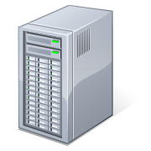

Riversand MDM Platform
Intelligence
Data
Warehouse
MDM
Data Quality
Compliance
Connect
Governance Policies
Analytics
Reporting
ERP
Promotions
Merge
De-duplication
Cleanse
Trusted Data
360 degree View
Marketing
CRM / salesforce
Legacy

Slide 8
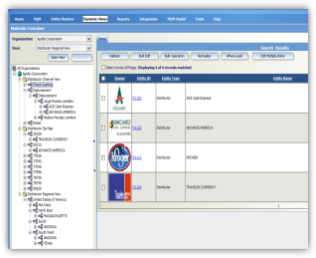
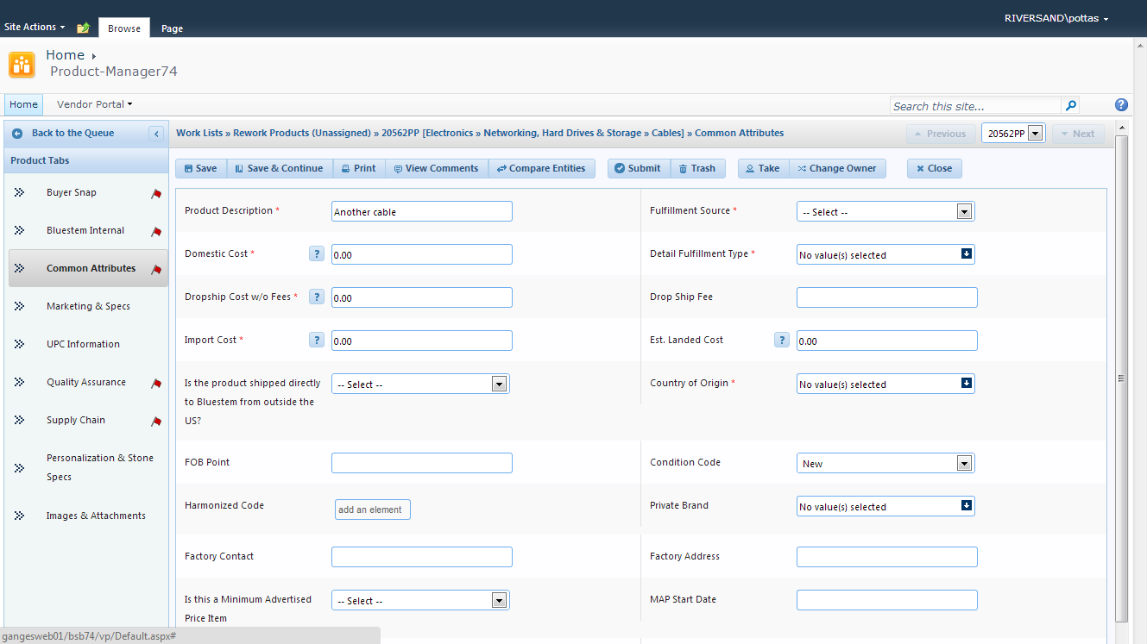
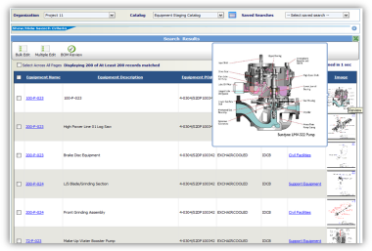
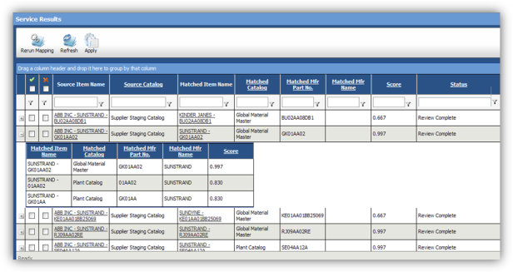
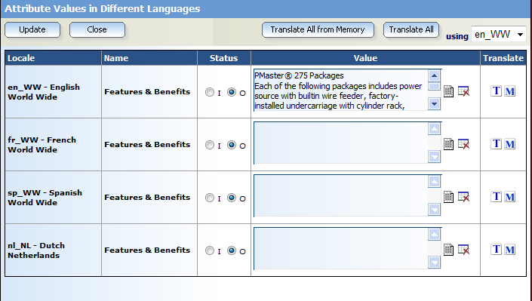
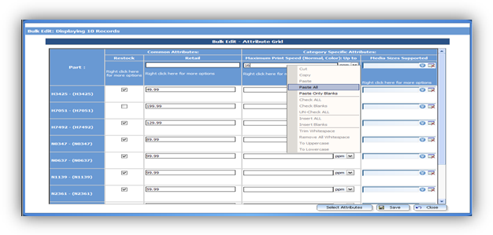
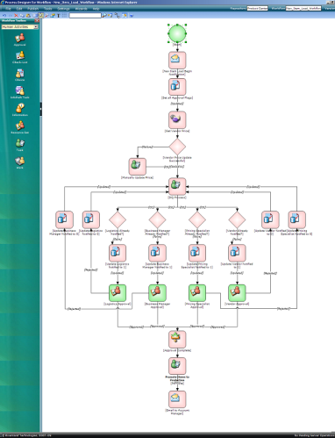
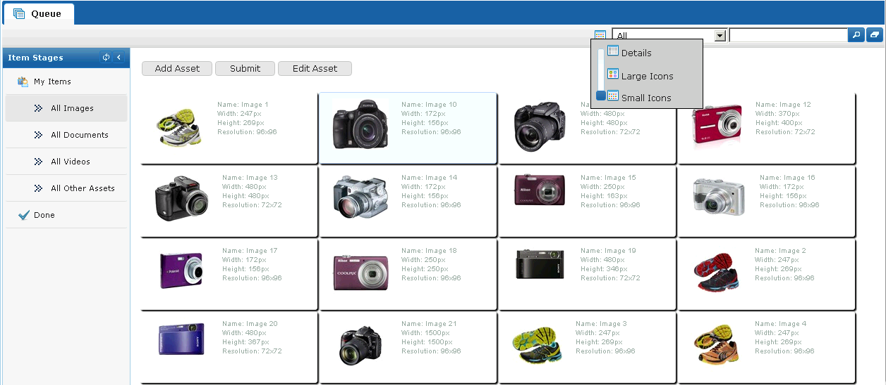
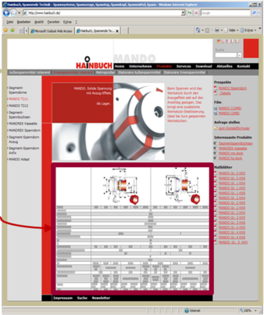
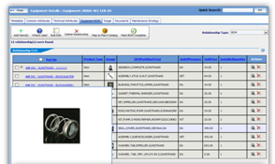
MDMCenter Solution Overview
Data Views
Vendor Portal
Reporting
Advanced Search
Data Quality Management
Data Globalization
Productivity Tools
BPM & Workflow
Digital Asset Management
Print Publishing
Relationship Management
Notes:
Please update this slide to NFP’s needs, if possible.

Slide 9



Examples of Riversand’s Multi-domain MDM clients
World’s Largest Generic Pharmaceutical Manufacturer. Managing Materials, Recipes, Product, and Vendor Master Data.
World’s Largest Apparel Manufacturer. Chose MDMCenter to Manage Vendor, Customer and Product Master Data across 32 brands globally.
A global healthcare company with expertise in medical devices, pharmaceuticals and biotechnology. Selected Riversand for Vendor data management and will be expanding to include other domains.

Slide 10
Thank you!

